Slide 1

PROJECT TITLE :CUSTOMERS DATA ANALYSIS
SUB TITLE: CUSTOMERS SHOPPING BEHAVIOR ANALYSIS
Presented by: Chilumakuri Hemalatha
Course : Data Analyst

Slide 2
Concepts:
Introduction
Problem Statement
Project objectives
Dataset Description
Data Preparation and Methodology
Shopping Distribution according by Gender & Gender-wise product sold
Total Revenue by Gender & Shopping distribution by age
Purchase Category Distribution Across key variables
Product Sales Distribution by Age Group & Revenue Analysis by Age group.
Payment method Distribution Across Key Variables
Payment Method Distribution
Business Insights & Recommendations
Conclusion

Slide 3
Introduction
This project focuses on analysing customer shopping behaviour using a shopping dataset collected from 10 different shopping malls in Istanbul between 2021 and 2023.
The objective of this analysis is to understand customer purchasing patterns based on gender, age groups, product categories, payment methods and shopping malls.
using Power BI, we analyse the data through interactive visualisations to identify customer preferences, sales trends and revenue-generating segments.

Slide 4
Problem statement:
The company needs to identify which customer groups contribute the most to sales.
It needs to determine the product categories that generate the highest revenue.
It should understand how purchasing behavior varies across gender ,age groups and categories.
It needs to Analyze whether payment methods influence customer purchasing patterns.
Question:
How can shopping trends and customer preferences be identified to increase sales and improve the customer experience ?

Slide 5

Project Objectives:
Analyze customer shopping behavior by gender and age group.
Identify the key customer segments driving sales and revenue.
Understand product category preferences and trends.
Analyze customer payment method preferences.
Provide insights to improve sales, marketing, and business decisions.

Slide 6
Dataset Description:
Rows
Columns
Shopping Malls
Categories
1,000
10
10
08
Column Name | Description
Invoice No | Unique transaction ID
Customer ID | Unique customer identifier
Gender | Customer gender(Male/Female)
Age | Customer age
Category | Product category purchased
Quantity | Number of items purchased
Price | Total transaction amount
Payment Method | Cash, Credit Card, Debit Card
Invoice Date | Transaction date
Shopping Mall | Mall where purchase occurred

Slide 7
Data Preparation and Methodology
The following steps were performed:
Imported the data from MY SQl:
Imported the CSV dataset into Power BI.
Checked the dataset for missing and duplicate values(no duplicates and missing values).
Verified the data types of all columns.
Created 4 age groups to analyse customer behaviour by age category.
Created DAX measures to calculate total transactions, products sold and revenue.
Created visualisations to analyse customer shopping patterns.
Tools Used:
MYSQL
Power BI Desktop
Power Query
DAX
Microsoft PowerPoint

Slide 8
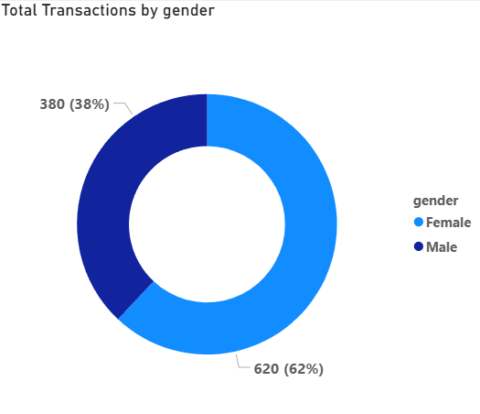
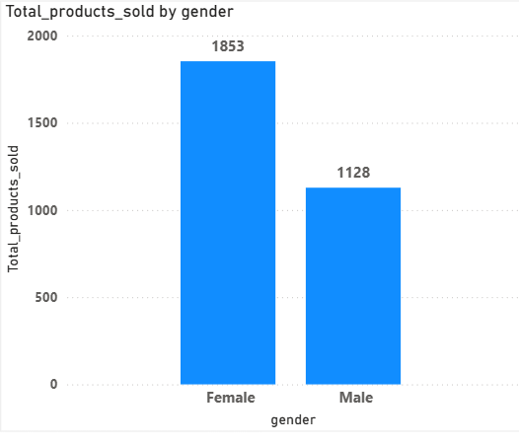
Visualization:
Shopping Distribution According to Gender
Gender-wise products sold
Female Dominance: Drives 62% of total
shopping transactions (620).
Female Sales: Female customers purchased
1853 products.
Male :captures 38% of total shopping transactions(380).
Male sales : Male customers purchased 1128
products, representing a solid but smaller share of
total sales.

Slide 9
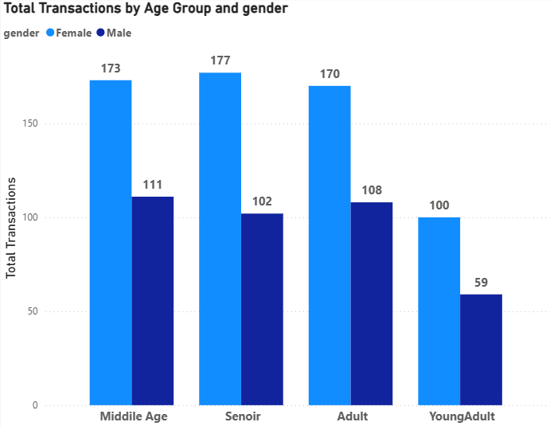
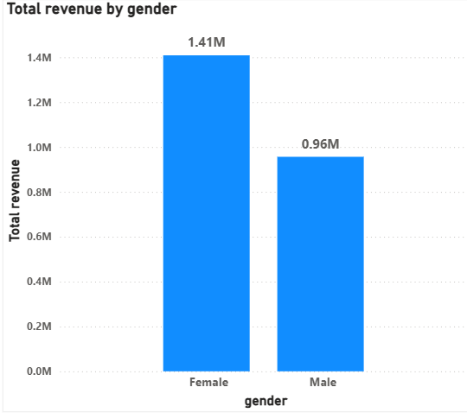
Total Revenue by Gender
Shopping Distribution By Age
Female customers generated 1.41M in revenue,
marking them as the highest-value consumer
segment.
Senior customers have the highest number of transactions, while Young Adult customers have the lowest.
Male customers generated 0.96M in revenue,
contributing a solid secondary financial stream.
Female customers generate more transactions than male customers across all age groups.

Slide 10
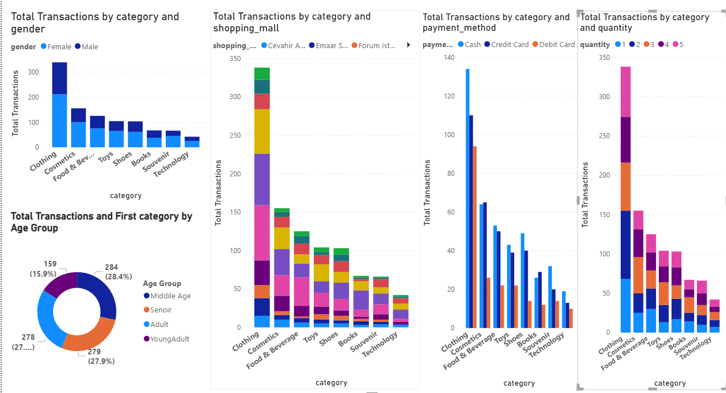
Purchase Category Distribution Across Key Variables:
1. Gender: Females made more purchases than males in clothing.
2. Shopping Mall: Clothing had the highest sales transactions
in all malls.
3. Payment Method: Cash was the most used payment method.
4. Quantity: Most customers purchased 1 item.
5. Age Group: Middle Age customers made the most purchases.

Slide 11
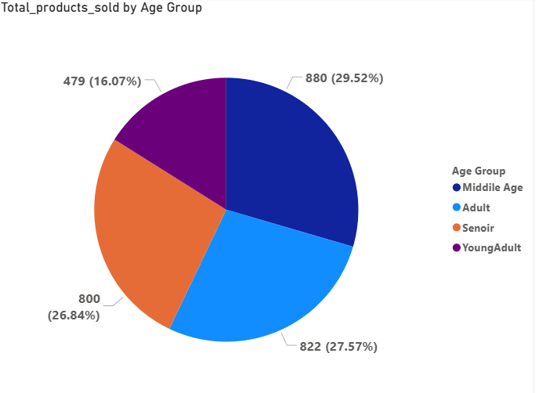
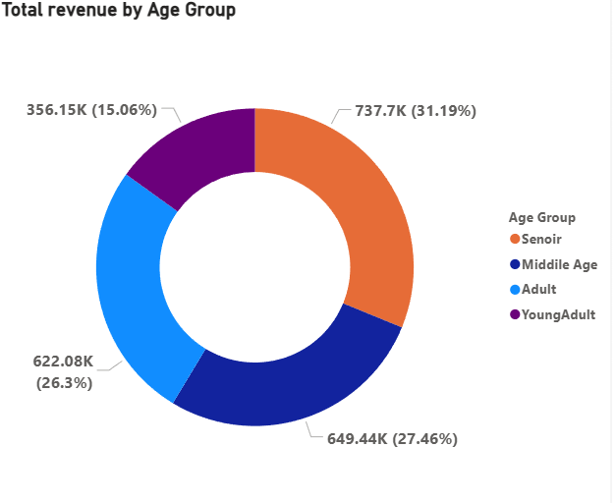
Product Sales Distribution by Age Group
Revenue Analysis by Age group
Senior customers generate the highest revenue (31.19%), making them the most valuable customer segment.
Middile age purchased the highest number of products
(880, 29.52%).
Young Adults purchased the lowest number of
products (479, 16.07%).
Young Adult customers contribute the lowest revenue (15.06%), indicating lower spending compared to other age groups.

Slide 12
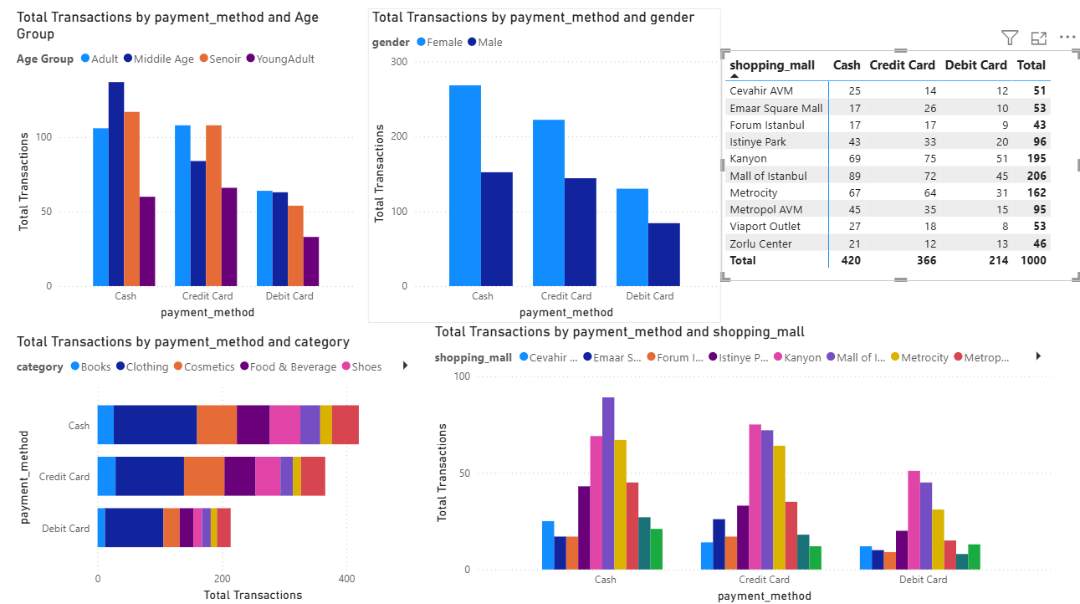
Payment method Distribution Across Key Variables:
Cash is the most preferred payment method across all age groups.
Female customers make more transactions than male customers across all payment methods.
Mall of Istanbul records the highest number of transactions among all shopping malls.
Clothing generates the highest number of transactions across all payment methods.
Cash is the most used payment method (420 transactions), followed by Credit Card (366) and Debit Card (214).

Slide 13
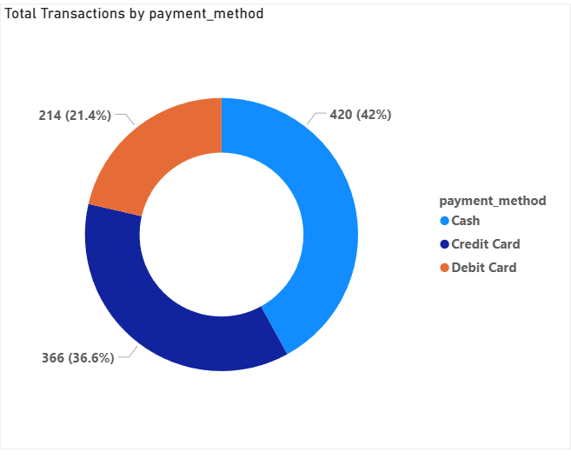
Payment Method Distribution:
Cash is the most preferred payment method, accounting for 42% (420) of all transactions.
Credit Cards contribute 36.6% (366) of transactions, making them the second most popular payment option.
Debit Cards account for 21.4% (214) of transactions, making them the least preferred payment method

Slide 14
Business Insights & Recommendation:
Key Findings from Customer Shopping
Behaviour:
Strategies to Improve Sales and Customer Satisfaction:
Female customers drive the highest sales and revenue.
Senior customers are the highest-spending segment.
Clothing is the top-performing product category.
Cash is the most preferred payment method.
Middle-aged customers purchase the most products.
Strengthen marketing toward female customers.
Focus on premium offerings for seniors.
Maintain strong clothing inventory.
Promote Credit/Debit Card usage through incentives.
Increase engagement with young adults through targeted promotions.

Slide 15
Conclusion:
This project helped us understand customer shopping behaviour across different genders, age groups, product categories, and payment methods.
Female customers contributed the highest number of transactions, product sales, and overall revenue.
Middle-Age customers purchased the most products, while Senior customers generated the highest revenue.
Clothing emerged as the most popular product category across all customer segments and shopping malls.
Cash was the most preferred payment method, followed by Credit Card and Debit Card transactions.
Power BI visualizations helped identify key shopping trends, customer preferences, and revenue-generating segments.
These insights can support better marketing strategies, inventory planning, customer engagement, and business growth.
Final Takeaway:
Data analysis enables businesses to better understand customer behaviour, improve sales performance, enhance customer satisfaction, and make smarter business decisions.

Slide 16
Thank you

